Slide 1
Lecture 7: Genetic Programming
Dr. Samar Hesham
Department of Computer Science Faculty of Computers and Artificial Intelligence
Cairo University
Egypt
11/19/2020
1

Slide 2
THE CHALLENGE
"How can computers learn to solve problems without being explicitly programmed? In other words, how can computers be made to do what is needed to be done, without being told exactly how to do it?"
Attributed to Arthur Samuel (1959)
11/19/2020
3

Slide 3
CRITERION FOR SUCCESS
"The aim [is] ... to get machines to exhibit behavior, which if done by humans, would be assumed to involve the use of intelligence.“
Arthur Samuel (1983)
11/19/2020
4

Slide 4
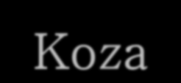


GENETIC PROGRAMMING (GP)
One of the central problems in computer science is how to make computers solve problems without being explicitly programmed to do so.
Genetic programming offers a solution through the evolution of computer programs by methods of natural selection. It is an extension of the Genetic Algorithm.
According to Koza, genetic programming searches the space of possible computer programs for a program that is highly fit for solving the problem at hand.
11/19/2020
5

Slide 5
Why Genetic Programming?
“For many problems in machine learning and artificial intelligence, the most natural representation for a solution is a computer program.” [Koza, 1994]
A parse tree is a good representation of a computer program for Genetic Programming
11/19/2020
6

Slide 6
GA flowchart
GP flowchart

Slide 7
Using Trees To Represent Computer Programs
(+ 2 3 (* X 7) (/ Y 5))
Functions
+
2
3
*
/
X
7
Y
5
Terminals
11/19/2020
8

Slide 8
GP Technical Summary
Representation | Tree structures
Recombination | Exchange of subtrees
Mutation | Random change in trees
Parent selection | Fitness proportional
Survivor selection | Generational replacement
9
11/19/2020

Slide 9
Genetic Operations
Random Generation of the initial population
of possible solutions
Mutation of promising solutions to create new possible solutions
Genetic Crossover of two promising solutions to create new possible solutions

Slide 10
Randomly Generating Programs
Randomly generate a program that takes two arguments and uses basic arithmetic to return an answer
Function set = {+, -, *, /}
Terminal set = {integers, X, Y}
Randomly select either a function or a terminal to represent our program
If a function was selected, recursively generate random programs to act as arguments

Slide 11
Randomly Generating Programs
(+ …)
+

Slide 12
Randomly Generating Programs
(+ 2 …)
+
2

Slide 13
Randomly Generating Programs
(+ 2 3 …)
+
2
3

Slide 14
Randomly Generating Programs
(+ 2 3 (* …) …)
+
2
3
*

Slide 15
Randomly Generating Programs
(+ 2 3 (* X 7) (/ …))
+
2
3
*
/
X
7

Slide 16
Tree based representation
Trees are a universal form, e.g. consider
Arithmetic formula
y
⎞
2 ⋅π + ⎛(x + 3) −
⎜
5 +1⎟
Logical formula
⎝ ⎠
(x ∧ true) → (( x ∨ y ) ∨ (z ↔ (x ∧ y)))
Program
i =1;
while (i < 20)
{
i = i +1
}

Slide 17
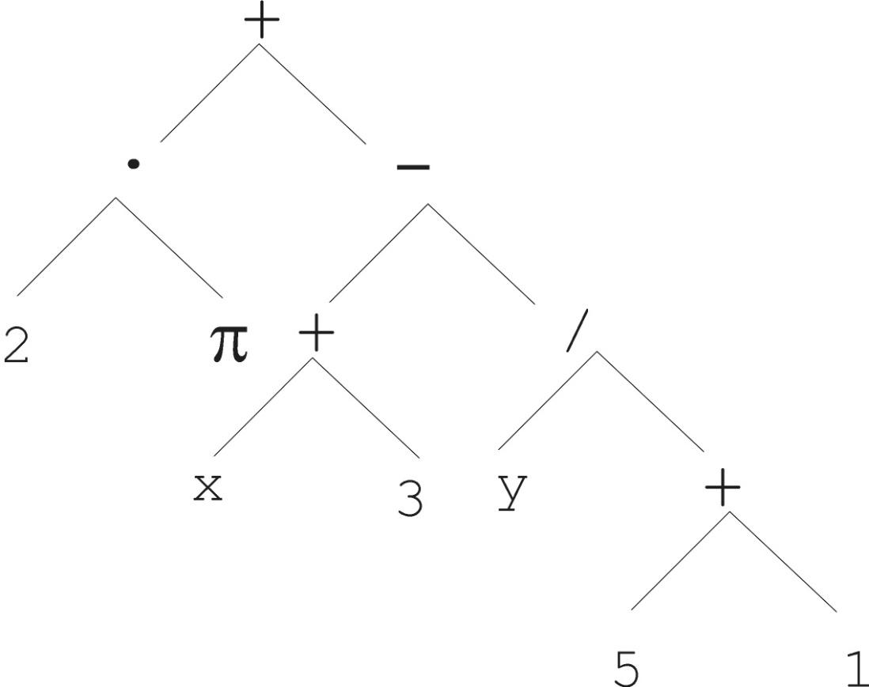
Tree based representation
y
⎞
2 ⋅π + ⎛(x + 3) −
⎜
⎝
5 +1⎟
⎠

Slide 18
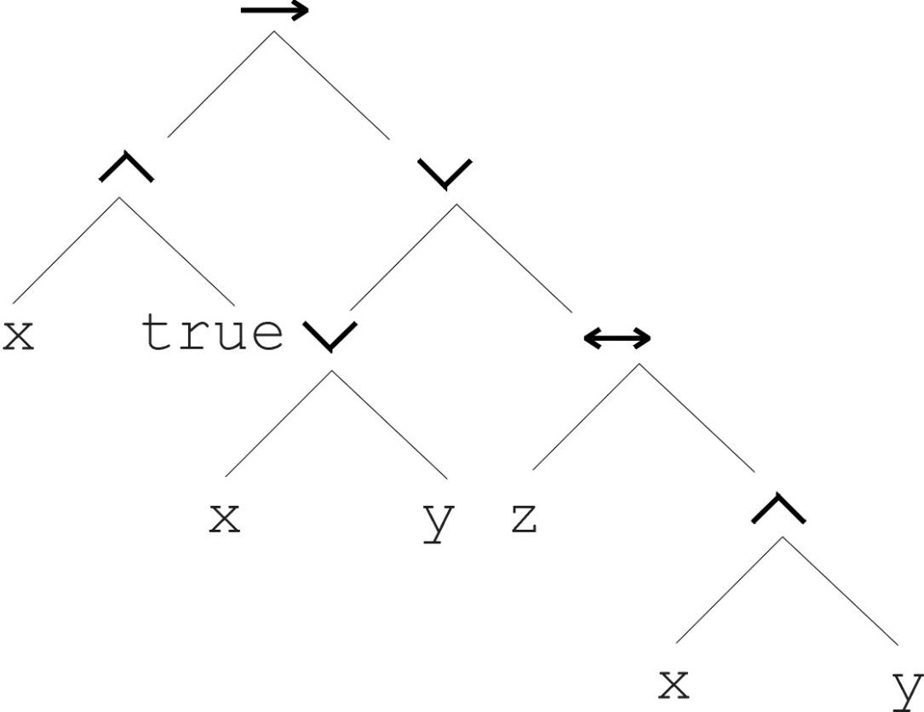
Tree based representation
(x ∧ true) → (( x ∨ y ) ∨ (z ↔ (x ∧ y)))

Slide 19
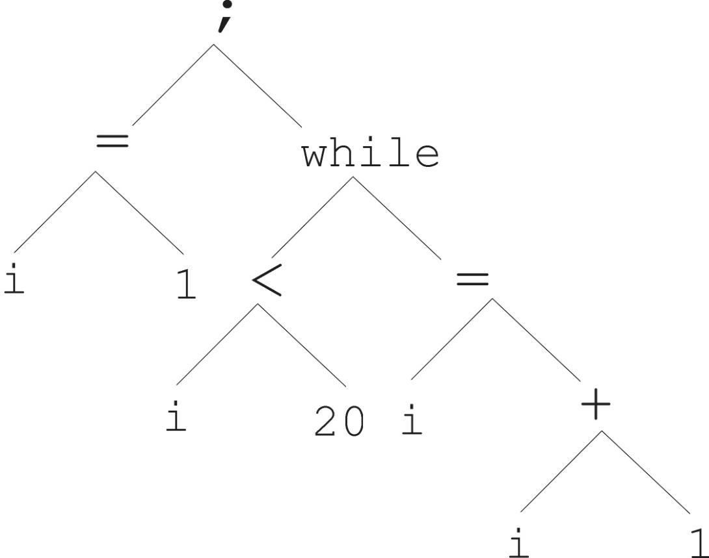
Tree based representation
i =1;
while (i < 20)
{
i = i +1
}

Slide 20
Tree based representation
In GA, chromosomes are linear structures (bit strings, integer string, permutations)
Tree shaped chromosomes are non-linear
structures
In GA, the size of the chromosomes is fixed
Trees in GP may vary in depth and width

Slide 21
Randomly Generating Programs
(+ 2 3 (* X 7) (/ Y 5))
+
2
3
*
/
X
7
Y
5

Slide 22
Mutation
Mutation has two parameters:
Probability p_{m} to choose mutation vs. recombination
Probability to chose an internal point as the root of the subtree to be replaced
Remarkably p_{m} is advised to be very small (Koza’92), like 0.05 (Banzhaf et al. ’98)
The size of the child can exceed the size of the parent

Slide 23
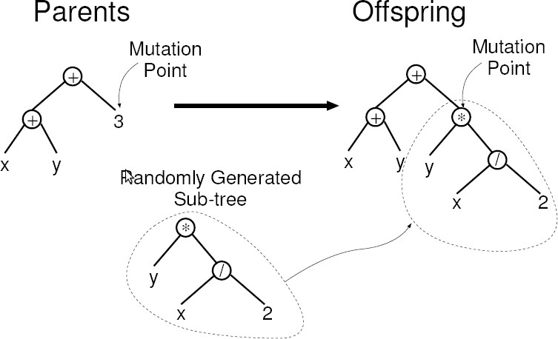
Mutation
Subtree Mutation: Replace the mutation point by randomly generated tree.
Point Mutation: Randomly select a node and replace it with another primitive.

Slide 24
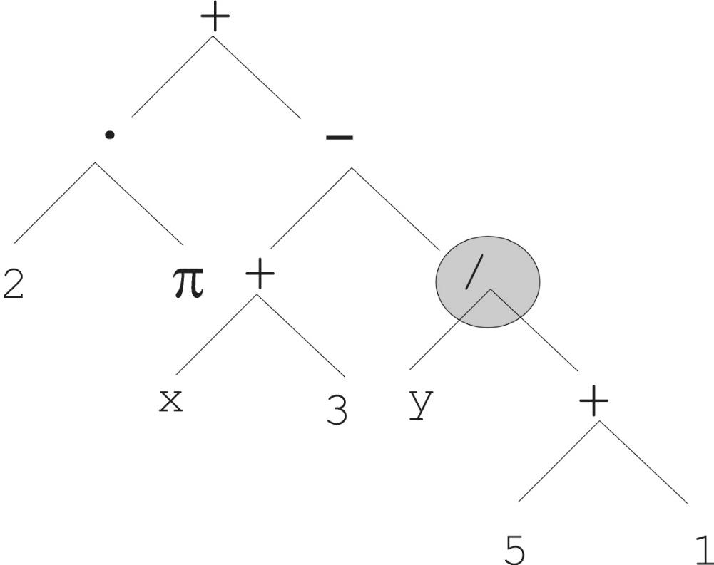
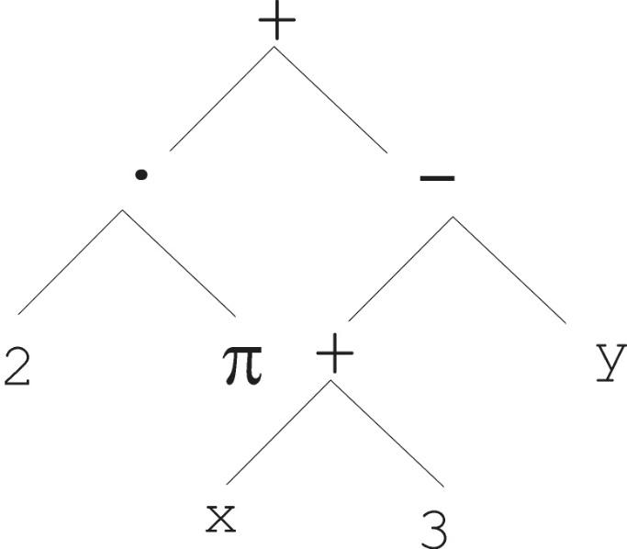
Mutation
Most common mutation: replace randomly chosen subtree by randomly generated tree

Slide 25
Mutation
(+ 2 3 (* X 7) (/ Y 5))
+
2
3
*
/
X
7
Y
5

Slide 26
Mutation
First pick a random node
(+ 2 3 (* X 7) (/ Y 5))
+
2
3
*
/
X
7
Y
5

Slide 27
Mutation
Delete the node and its children, and replace with a randomly generated program (Subtree)
(+ 2 3 (+ (* 4 2) 3) (/ Y 5))
+
2
3
+
/
* 3
Y
5
4
2

Slide 28
Recombination = Crossover
Most common recombination: exchange two randomly chosen subtrees among the parents
Recombination has two parameters:
Probability p_{c} to choose recombination vs. mutation
Probability to chose an internal point within each parent as crossover point
The size of offspring can exceed that of the parents

Slide 29
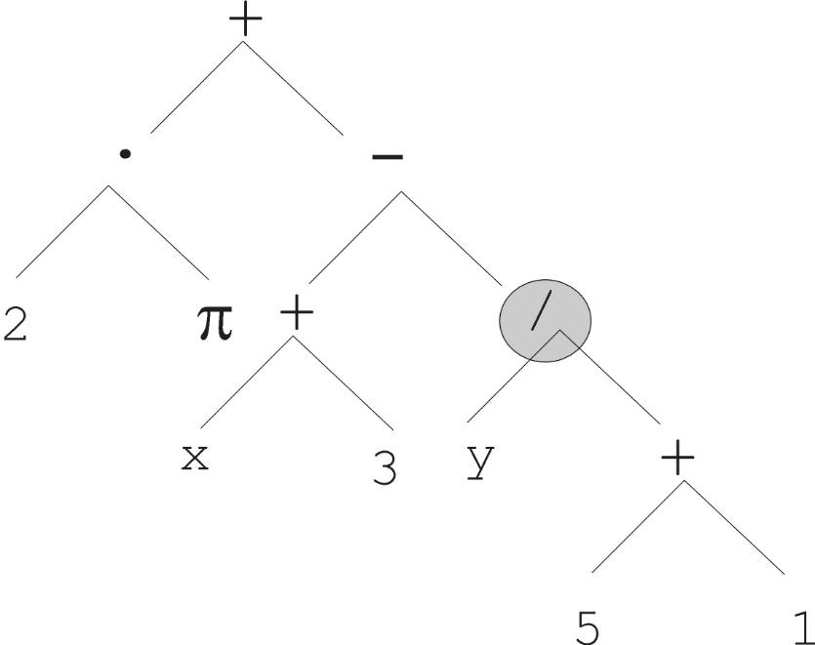
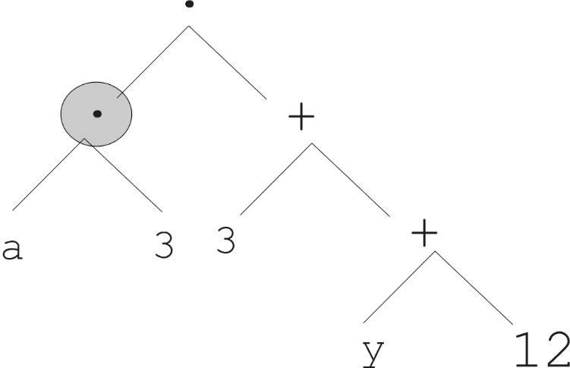

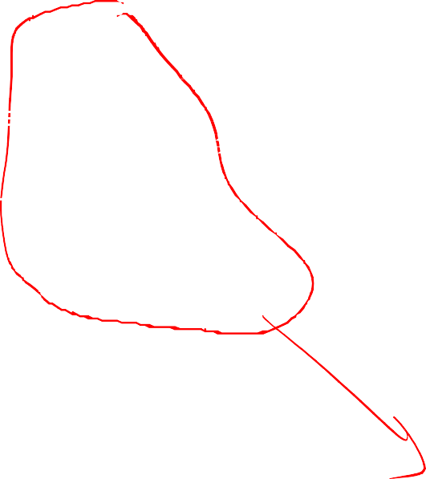
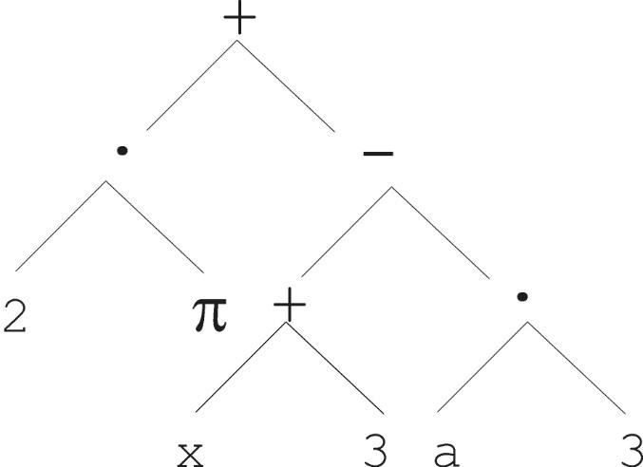
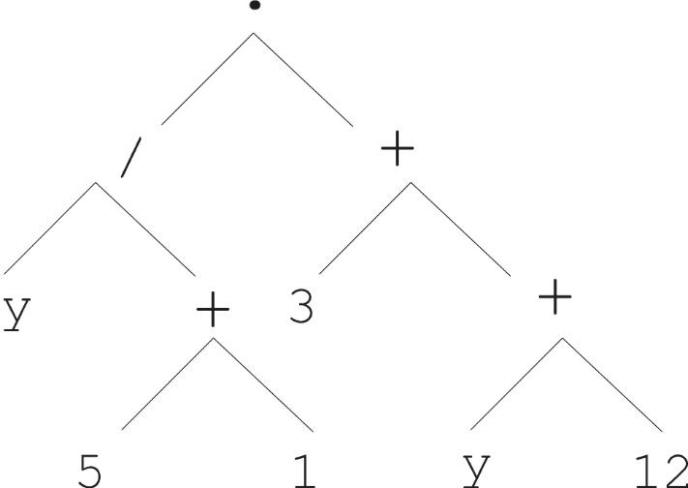

Subtree Crossover
Parent 1
Parent 2
Child 1
Child 2

Slide 30
Crossover
(+ X (* 3 Y))
(- (/ 25 X) 7)
+
-
X
*
/
7
3
Y
25
X

Slide 31
Crossover
(+ X (* 3 Y))
(- (/ 25 X) 7)
Pick a random node in each program
+
-
X
*
/
7
3
Y
25
X

Slide 32
Crossover
(+ X (* (/ 25 X) Y))
(- 3 7)
+
Swap the two nodes
-
X
*
3
7
/
Y
25
X

Slide 33
What About Just Randomly Generating Programs?
Is Genetic Programming really better than just randomly creating new functions?
Yes!
Pete Angeline compared the result of evolving a tic-tac-toe algorithm for 200 generations, with a population size of 1000 per generation, against 200,000 randomly generated algorithms
The best evolved program was found to be significantly superior to the best randomly generated program [Genetic Programming FAQ, 2002]
The key lies in using a fitness measure to determine which functions survive to reproduce in each generation

